Slide 1
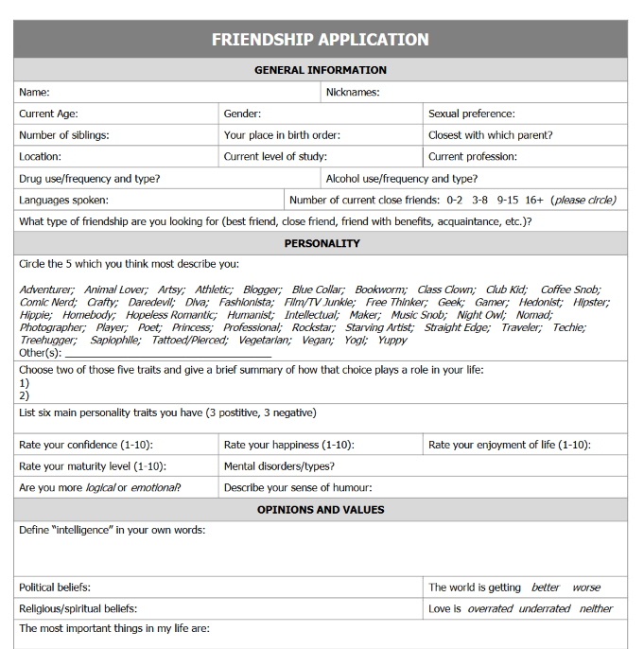
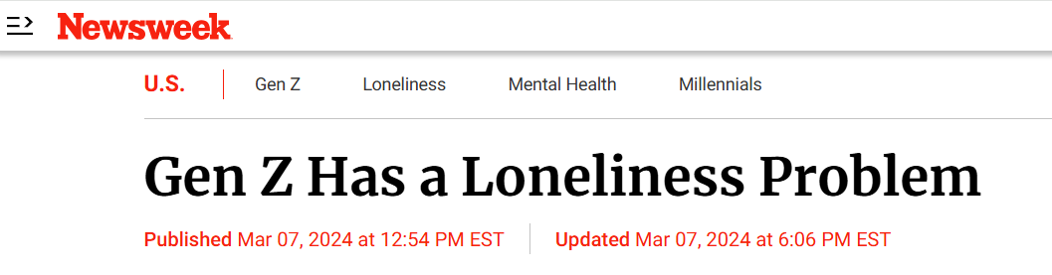

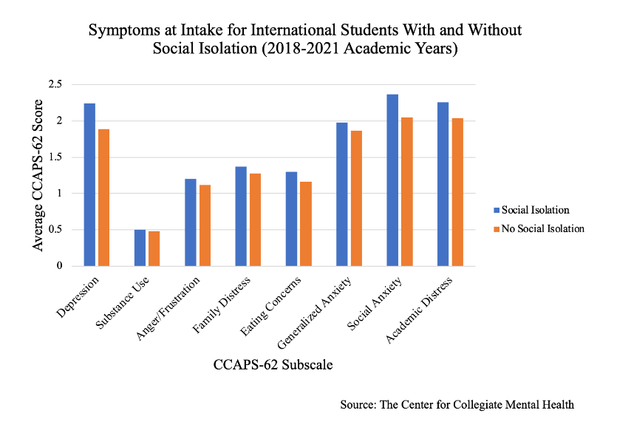
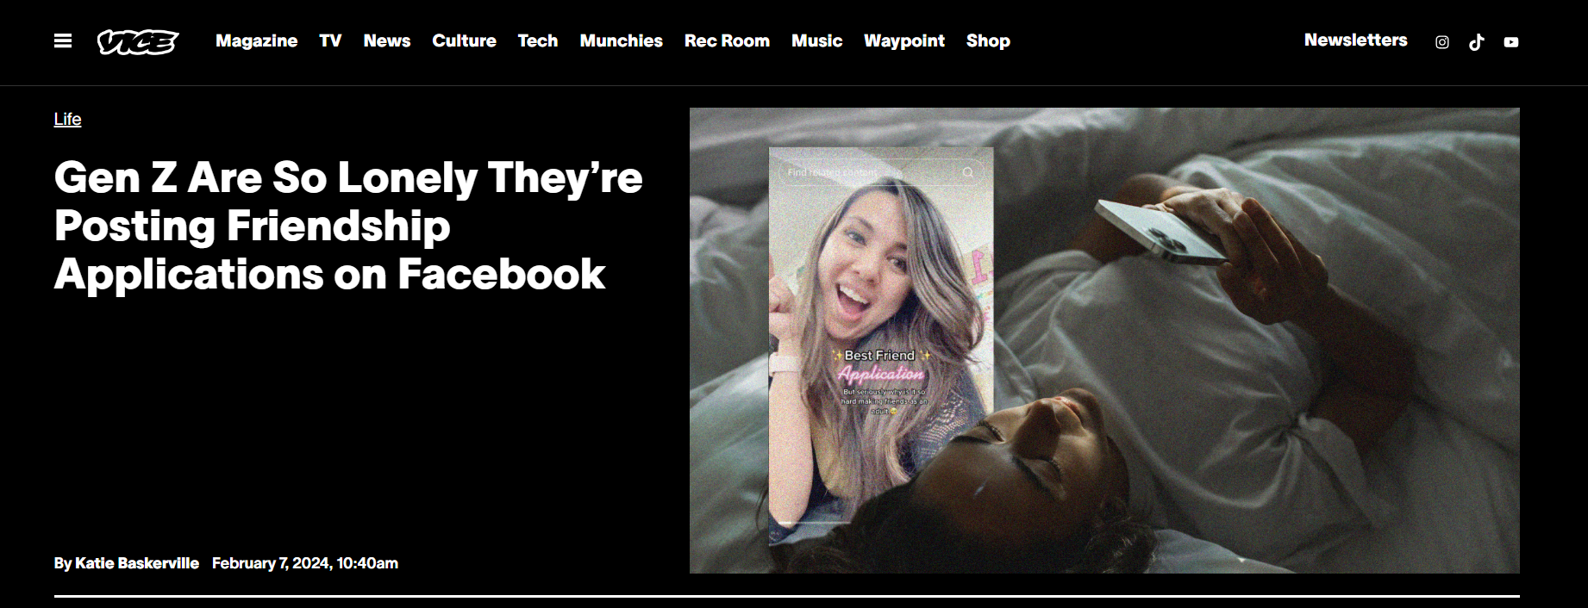
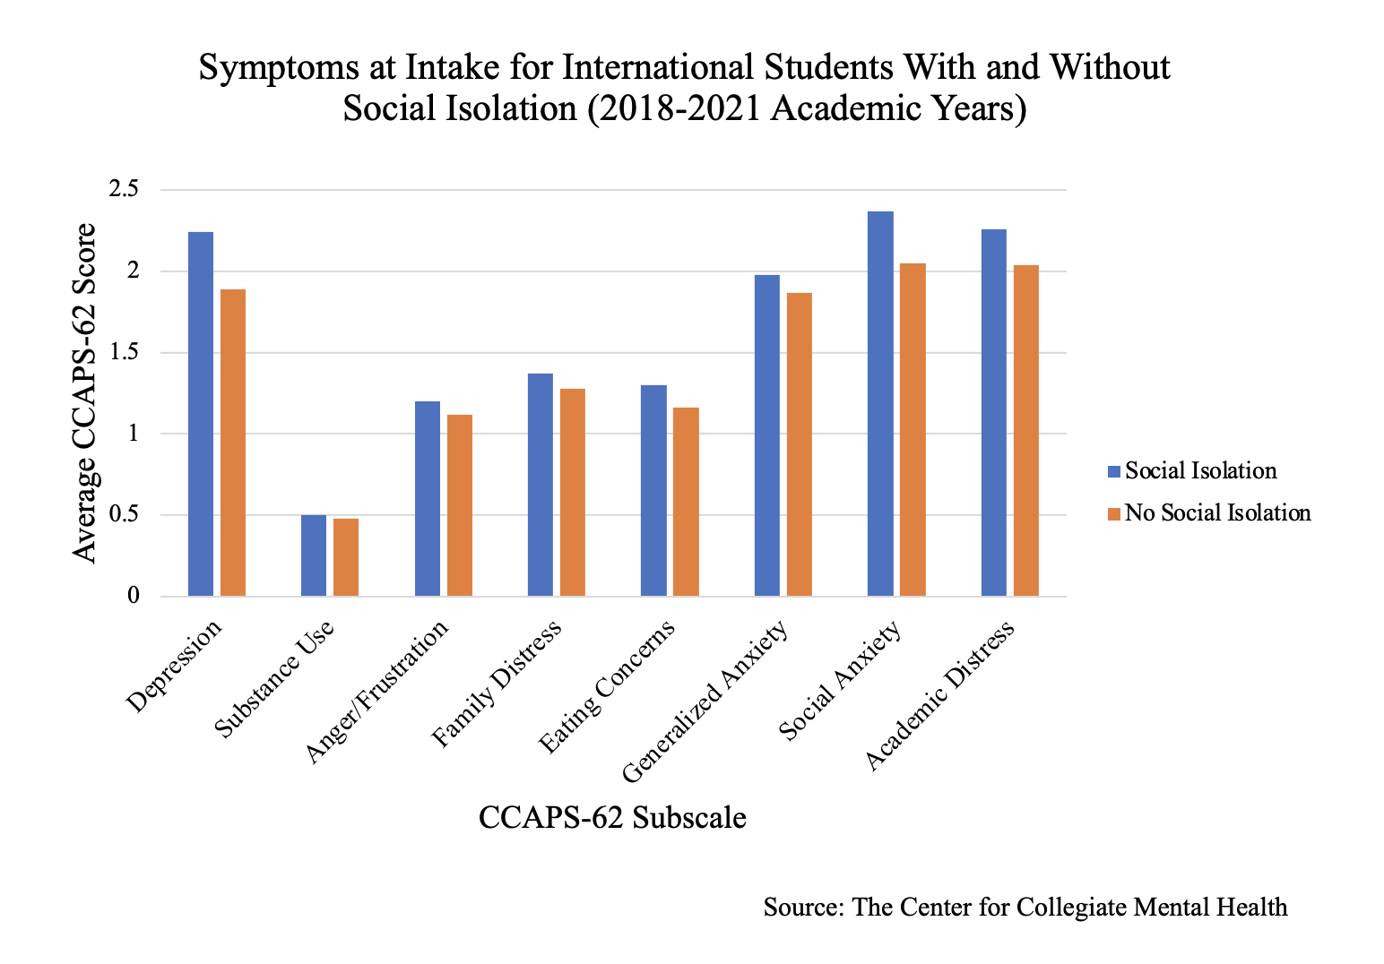
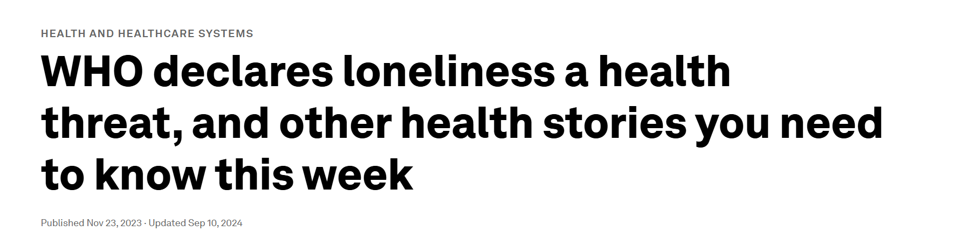

Slide 2
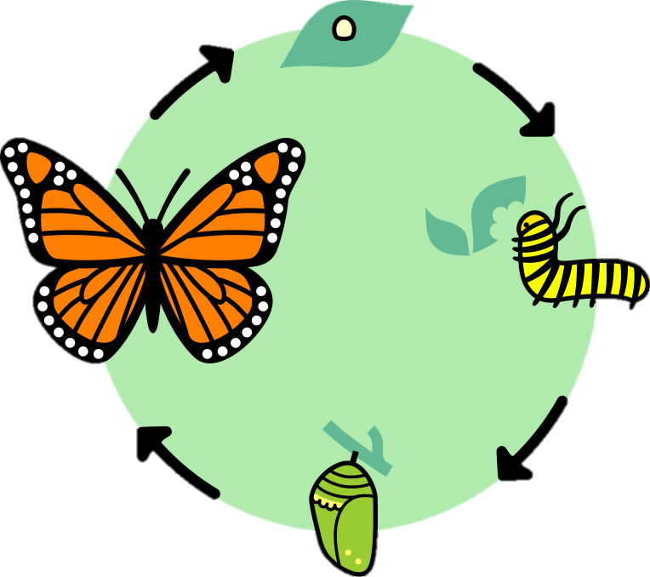
Lifecycle of the Project
1
Caterpillar -
Identifying the Problem
l
2
Chrysalis -
Finding a Solution
3
Butterfly -
Creating the Project

Slide 3
1
Caterpillar -
Identifying the Problem

Slide 4
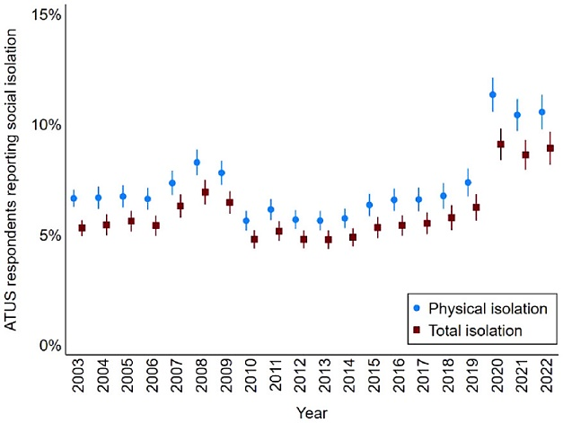
Social Isolation
Social isolation is a condition characterized by a lack of contact with other people and being disengaged from groups and social activities.
Source: BMC Public Health
Globally and across age groups, the incidence of isolation and loneliness is on the rise.
Source: Swiss Rea
Approximately 1 in every 14 ATUS respondents did not engage in a single face-to-face interaction during their diary days from 2003 to 2022.
Source: Sage Journal
American Time Use Survey (ATUS)

Slide 5
2
Chrysalis -
Finding a Solution

Slide 6
Changes in Socialisation
Communication is an art. Socialising in a better manner is always a worth mentioning skill. Today’s generation is more comfortable socialising on the internet than in real life.
Source: The Financial Express
Deloitte's survey found that (…) almost half (48%) of these younger generations (Gen Zs, Millennials) engage more with others on social media than in the physical world.
Source: ZDNET
New forms of relationship over the Internet are internalized as daily leisure habits. Social media is a great way to connect people with similar interests, whether it’s sports, music, art, activism, or anything else.
Source: world.edu

Slide 7
3
Butterfly -
Creating the Project

Slide 8

Mariposa - The Social Butterfly

Slide 9

Mariposa is…
a messaging site on the web that lets people talk to others, while offering the chance to stay safe and anonymous.
A "social butterfly" describes someone who's socially oriented, outgoing, and often very charismatic and charming.
Source: mindbodygreen

Slide 10
Anatomy of the Butterfly – How it works

Slide 11
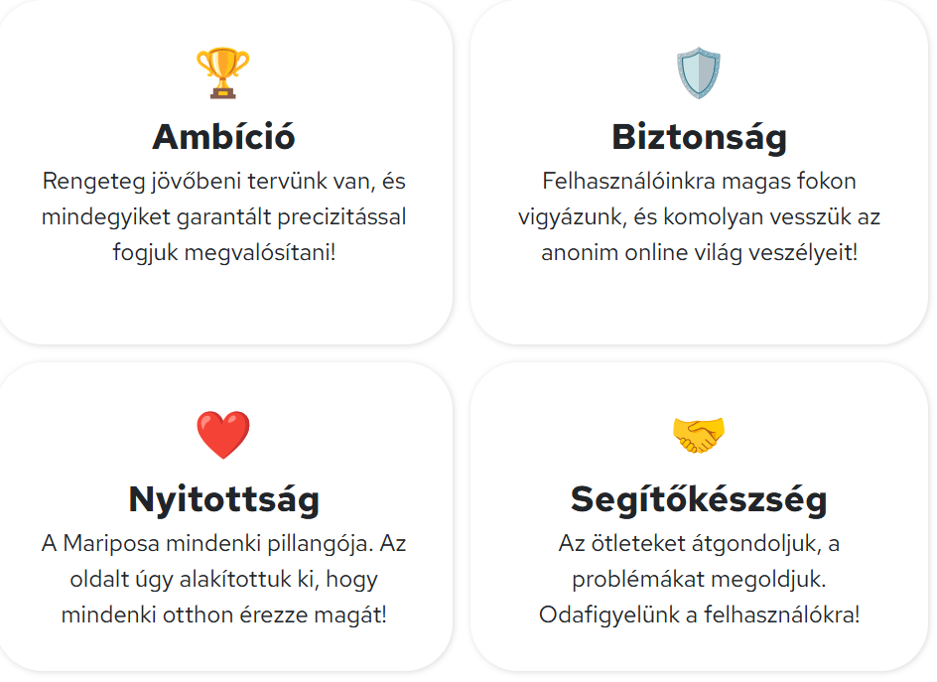
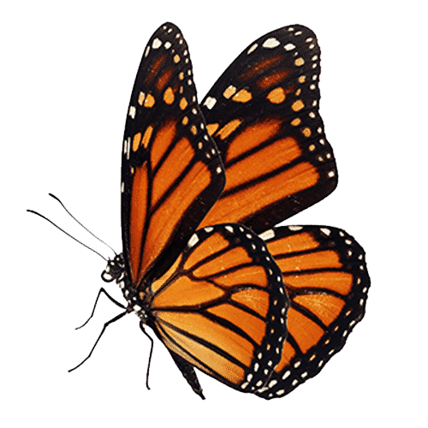
Look and Feel
1. Meaningful brand colour inspired by butterflies
2. Use of emojis as icons for „chatty” feeling
#ffbc2f
RGB(255, 188, 47)
CMYK(0%, 26%, 82%, 0%)
„Orange is a vibrant and energetic color that represents enthusiasm, creativity, and warmth.”
Source: Color Psychology
Font: Noto Color Emoji

Slide 12
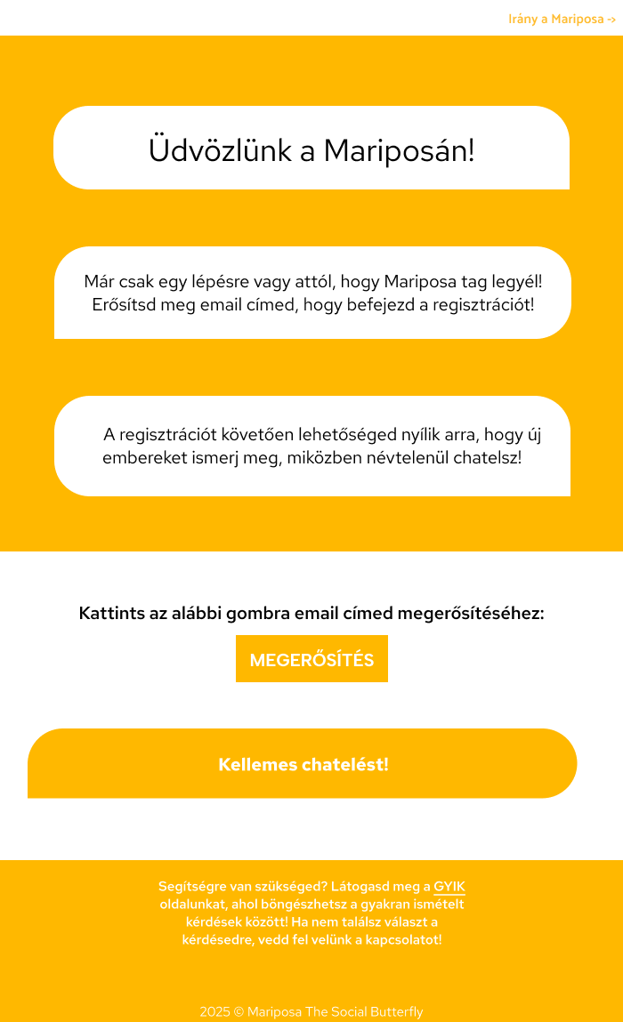
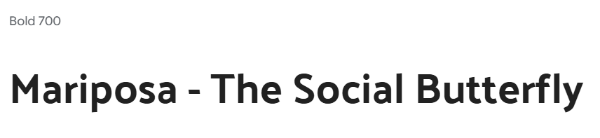
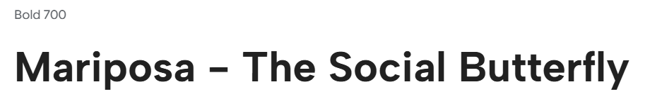
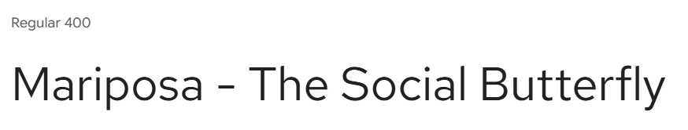
Look and Feel
3. Three different brand fonts for clearer user view
4. Thematic email design
The brand font: Palanquin
For buttons and navigation links: Albert Sans
For texts and messages: Red Hat Text

Slide 13
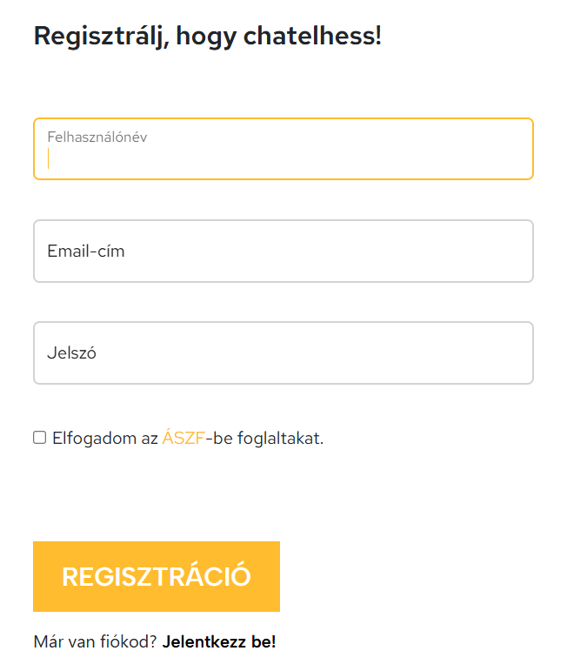
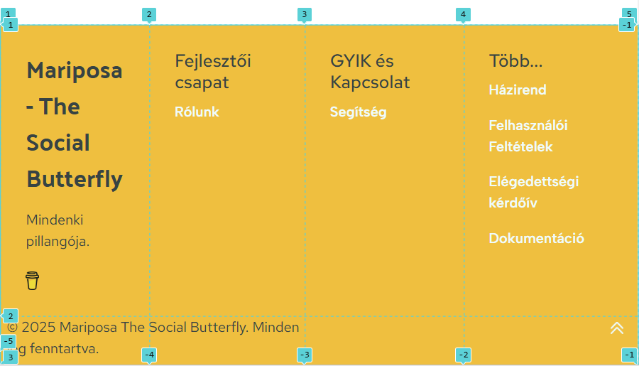

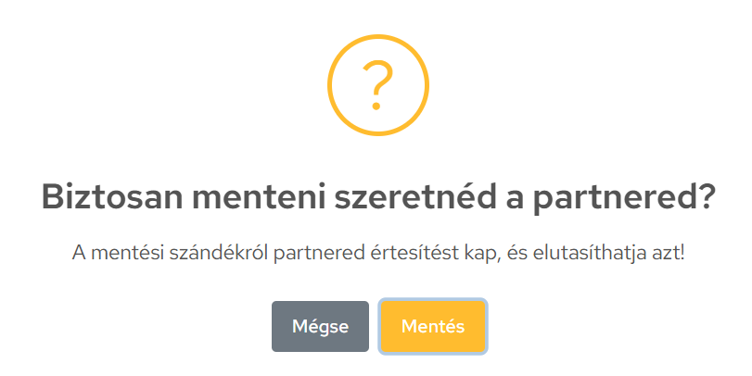


Frontend
Bootstrap - Floating labels, grid
SweetAlert – Popup alerts
CSS grid – Responsivity, alignment

Slide 14
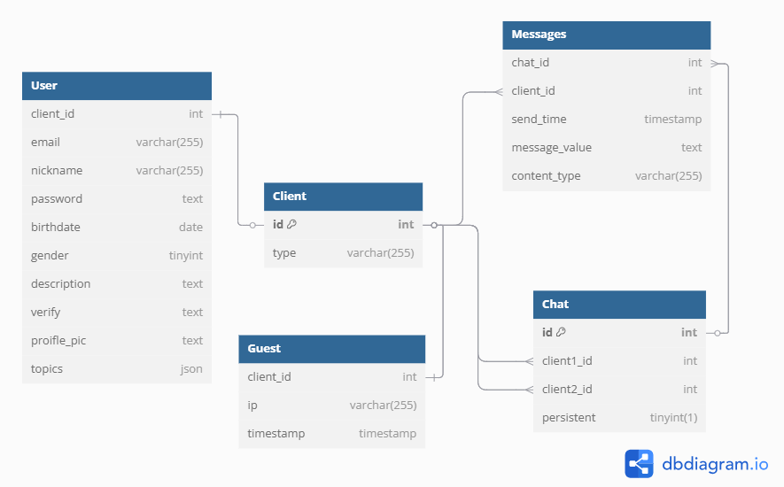
Database

Slide 15
Interactions
Sign up
Login
Stay logged in (with Cookies)
Forgot password
Change profile settings
Paginator
Match users
Save, delete report users
Receiving emails
Session
Real-time messaging

Slide 16
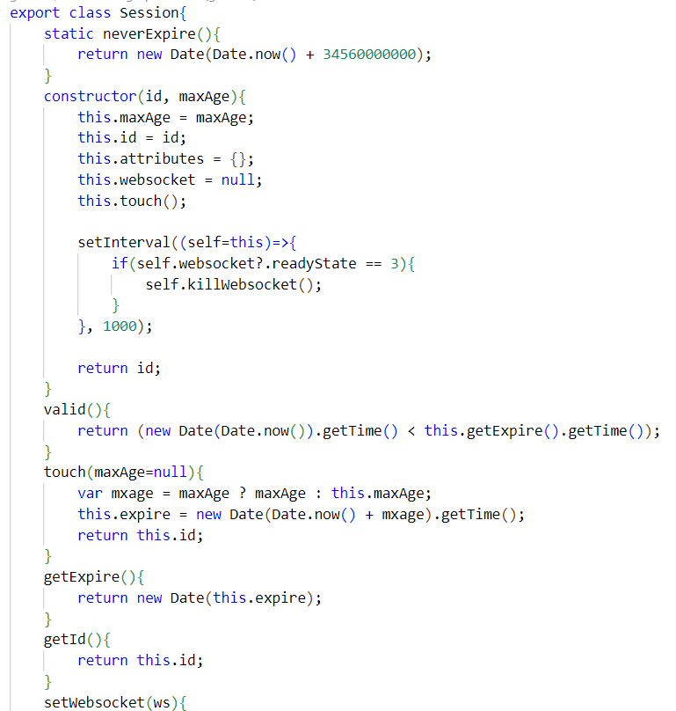
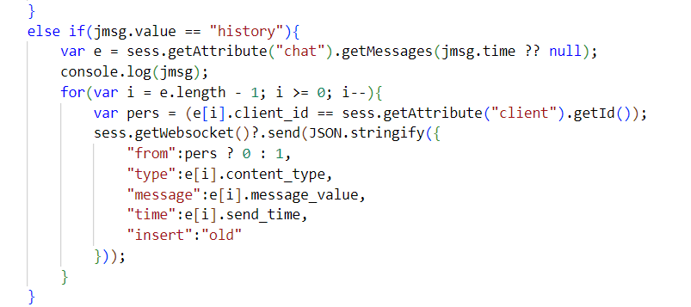
Session, messaging, paginator
Session:
Own controller
Logged in users have an ID
Stores data
Real-time messaging:
WebSocket
Logged in user only
WebSocket stored in Session
Paginator:
Not in whole
20 messages at a time
Triggered by scrolling
One pack of messages based on time of last sent

Slide 17
Working in a Colony
- Hardships and overcomings

Slide 18
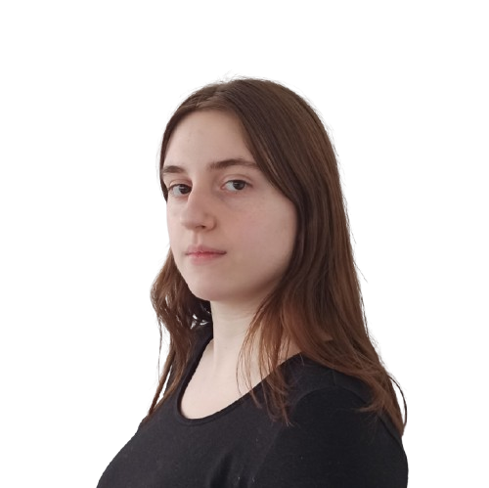
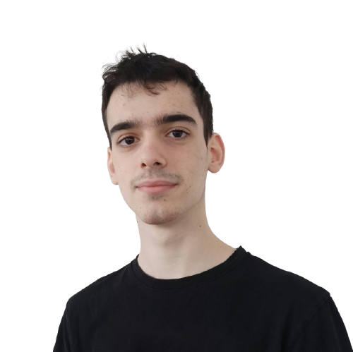
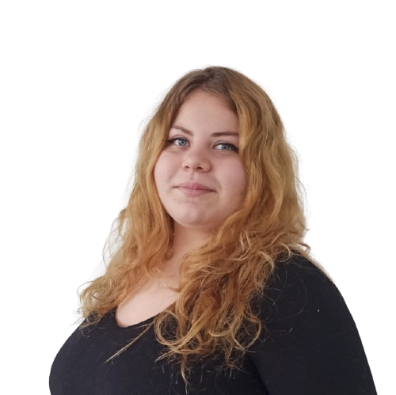


Our Team
Backend Dev
Lead Designer
Co-designer
Frontend Dev
Database Specialist
Manual Tester
Manual Tester
Copywriter
Project Manager
Dávid Gócza
Xénia Roxána Csizmadia
Kamilla Anna Horváth
GitHub for version control and collaboration
Jira for project management

Slide 19
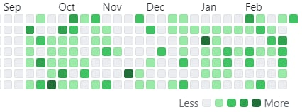
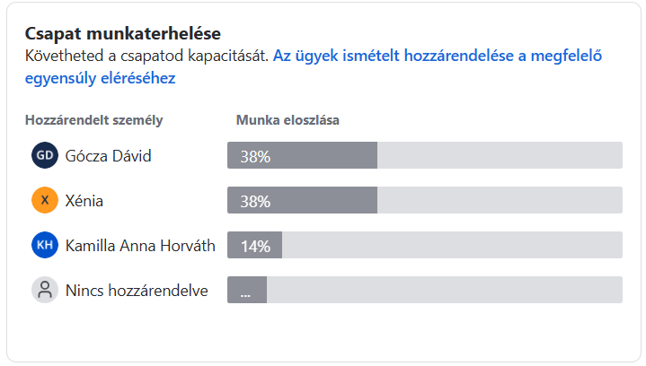
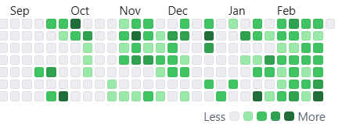
GitHub & Jira
Jira tasks
Dávid’s GitHub commits
Xénia’s GitHub commits

Slide 20
Test Flight
- Testing and Bugs

Slide 21
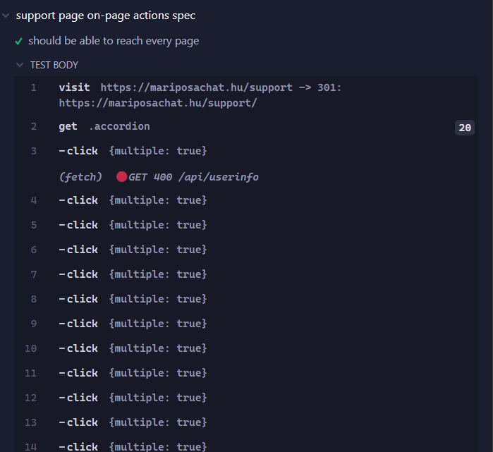
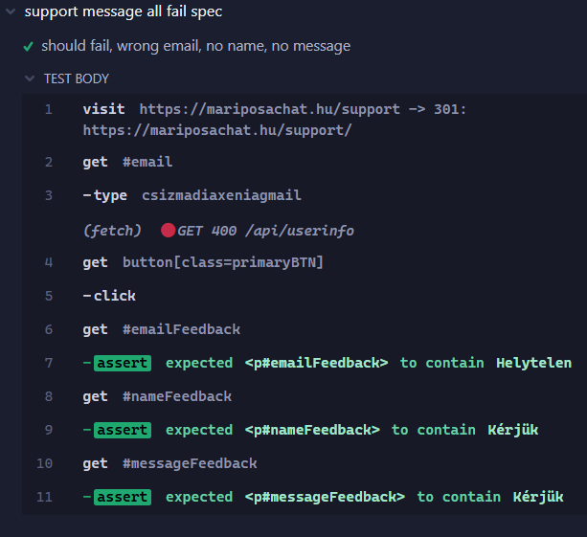
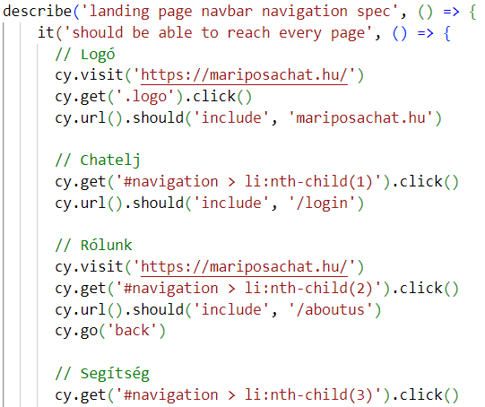
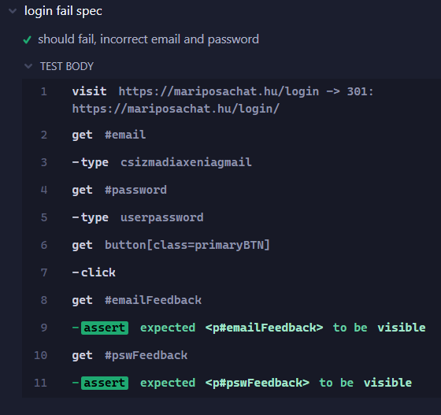
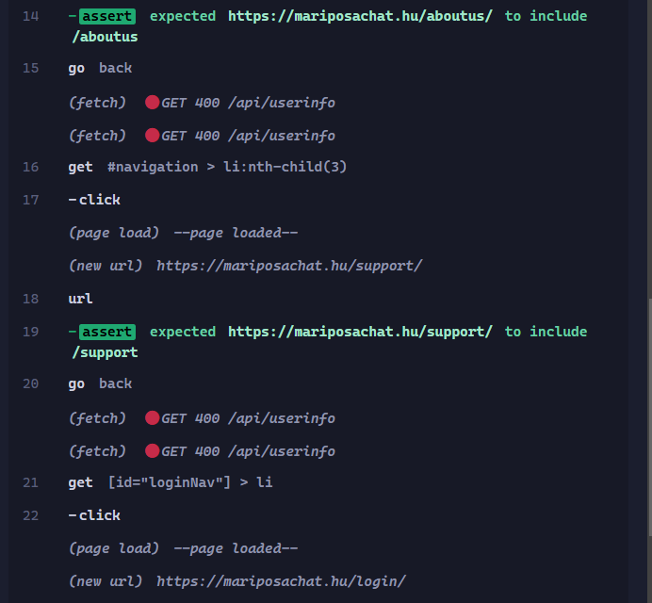
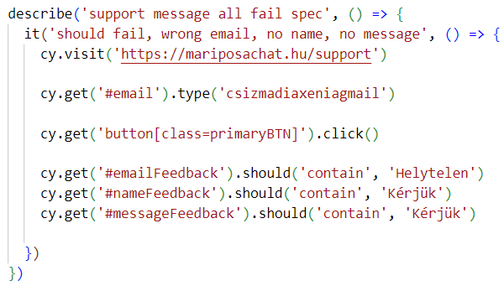
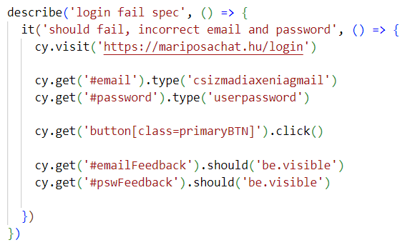
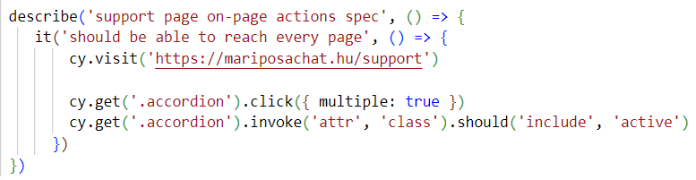
Auto Tests
Page actions
Support message
Login
Navbar navigation

Slide 22
Manual User Flow Tests
Sign up → Check emails → Log in → Chat site → New partner → Save found partner → Chat with → Delete partner → Re-draw → Save found partner → Back to first chat → Report partner → Check emails
Login → Profile settings → Change Fullname + Gender + Birthdate + Password → Log out → Log in → Delete account → Create new account (same email address)

Slide 23
Second Metamorphosis
- Future of Mariposa

Slide 24






What is Left
Toggle certain profile settings
Algorithm for Interests
Notifications
Two-factory authentication
Admin page for users, reported users and support messages
Proper HTML/CSS documentation with PHP layout

Slide 25
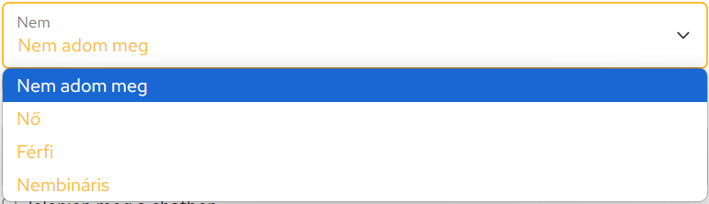
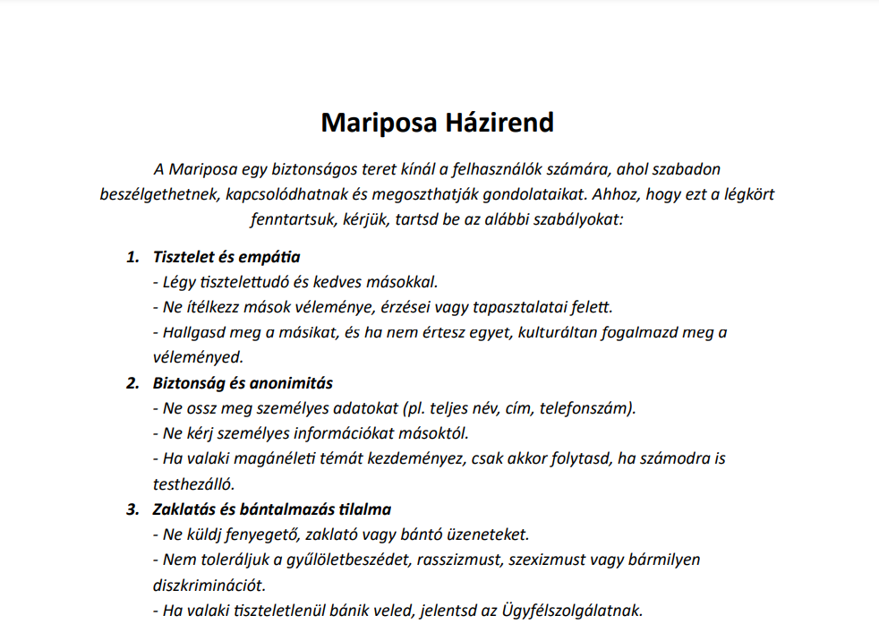
Inclusivity, diversity and accessibility
1. Changable gender
2. Clear policy promoting kindness and empathy
3. Using alternative text for visually impaired people

Slide 26




Future Updates
Who let the moths out?
Social Points
Night Mode including thematic change
Collecting Flowers, an opportunity for monetization
AI usage
Around the world
Implementing AI for hateword filtering
Multiple language platform, international servers

Slide 27


Thank You For Your Attention!
Dávid Gócza
Xénia Roxána Csizmadia
Kamilla Anna Horváth
Mariposa
This presentation includes icons by Flaticon, and pictures by Freepik. Other image sources: Google

